Slide 1
Appendix
More Goodies for Designers

Slide 2
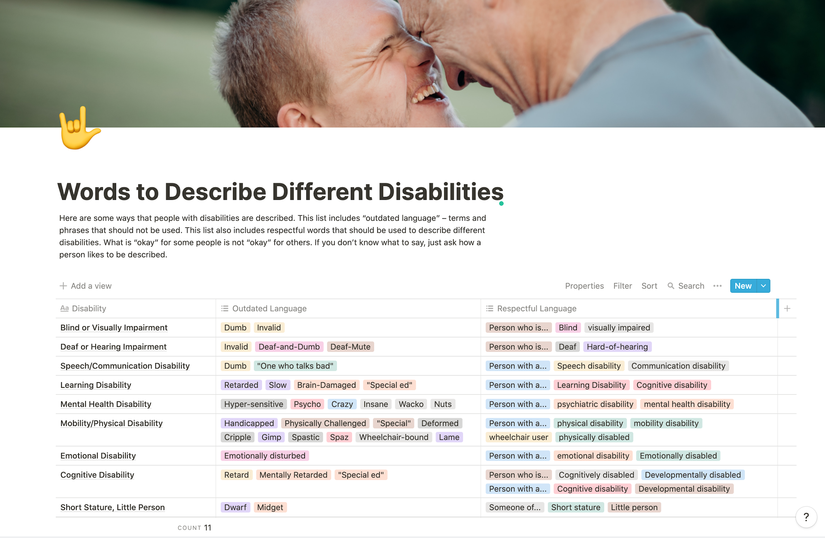
bit.ly/describing-disabilities

Slide 3
Accessible Typography
Minimize confusion, Maximize understanding

Slide 4
Accessible Typography - What to look for?
Typically people with dyslexia experience some of the following when reading:
Letters or words moving or spinning on the page
Confusion around spacing between letters and individual letters such as confusing the letter ‘m’ with the letters ‘rn’ when written together as in: modern and modem
Mixing up letters with their mirror images such as: ‘b’ and ‘d’, ‘p’ and ‘q’

Slide 5
Accessible Typography - Best Practices
Here are some things you can do to make your digital communications as accessible as possible:
Use a small number of fonts, ideally only 1 or 2 for headings and body text.
Good color contrast between the text and the background.
A recommended minimum font size is 12 pt.
Use bold to add emphasis rather than italics or UPPERCASE.
Don’t animate text and avoid making the letters flash or blink.

Slide 6
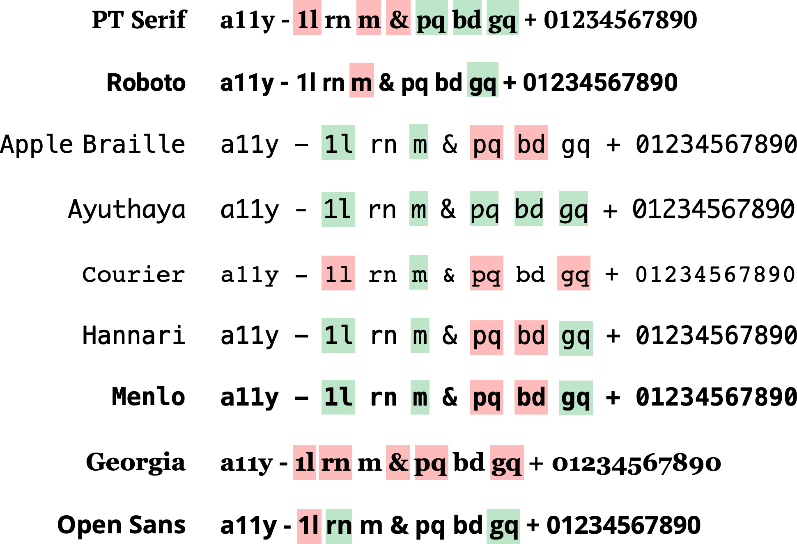
Accessible Typography - Examples

Slide 7
Accessible Typography - Examples

Slide 8
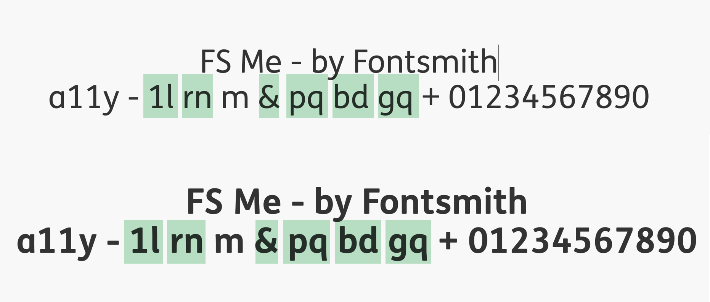
Accessible Typeface - FS Me by Fontsmith
https://www.fontsmith.com/fonts/fs-me/styles/family

Slide 9
Wayfinding
Interaction Design for Assistive Technologies

Slide 10
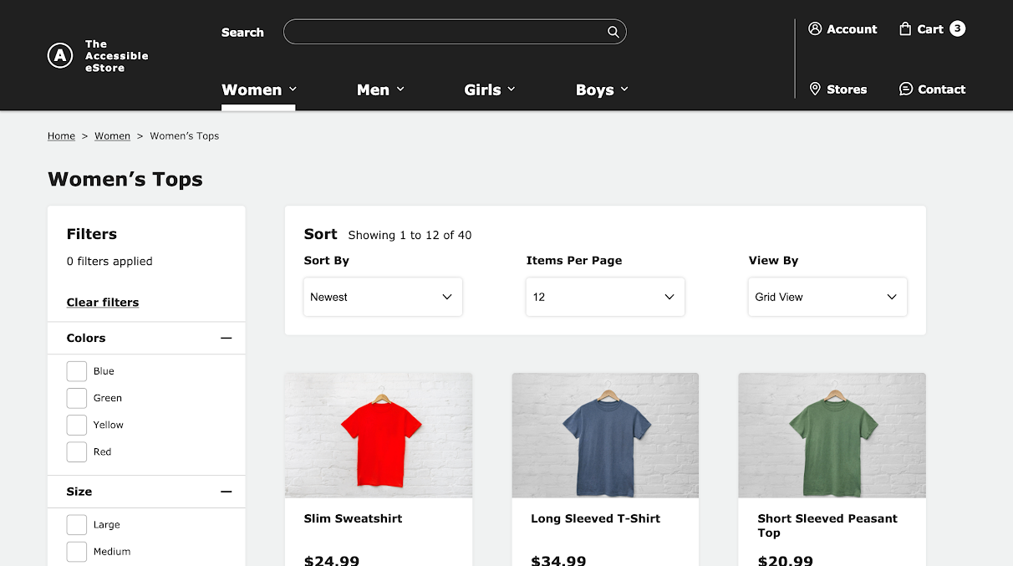

Slide 11
2
7
8
1
3
4
5
6
9
10
11
12
13
14
15
16

Slide 12
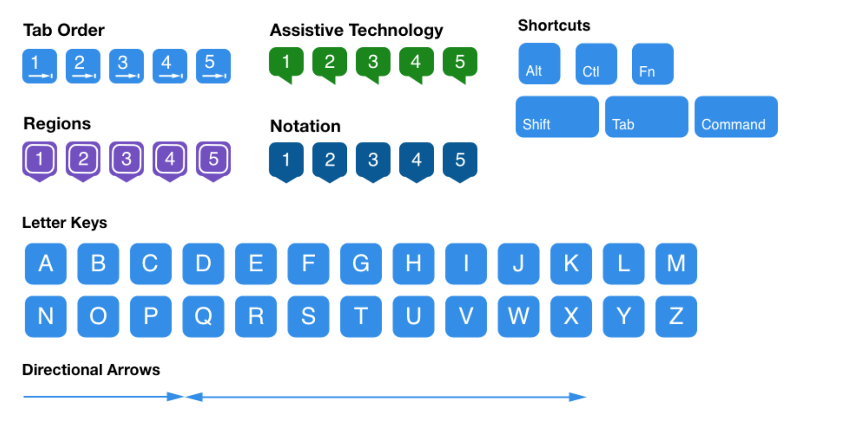
Accessibility Bluelines
Method by Jack Nicolai, Adobe Systems, later extended by Jeremy Elder, GitLab

Slide 13
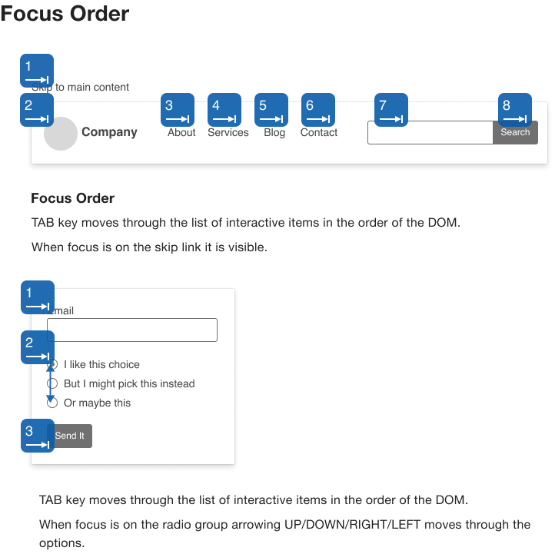
Extended by Jeremy Elder, GitLab

Slide 14
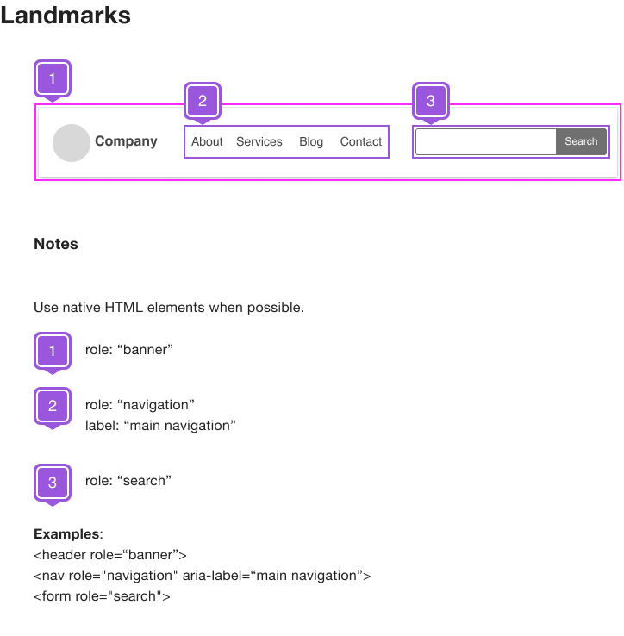
Extended by Jeremy Elder, GitLab

Slide 15
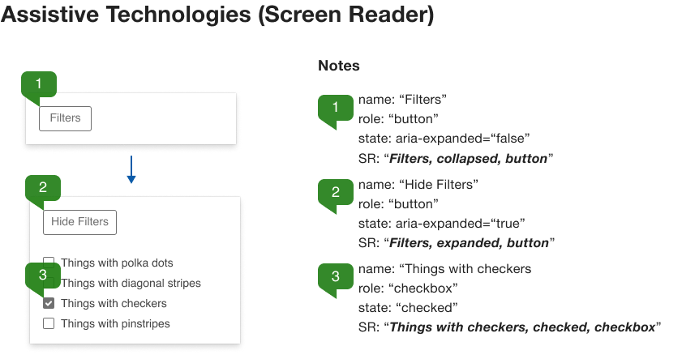
Extended by Jeremy Elder, GitLab

Slide 16
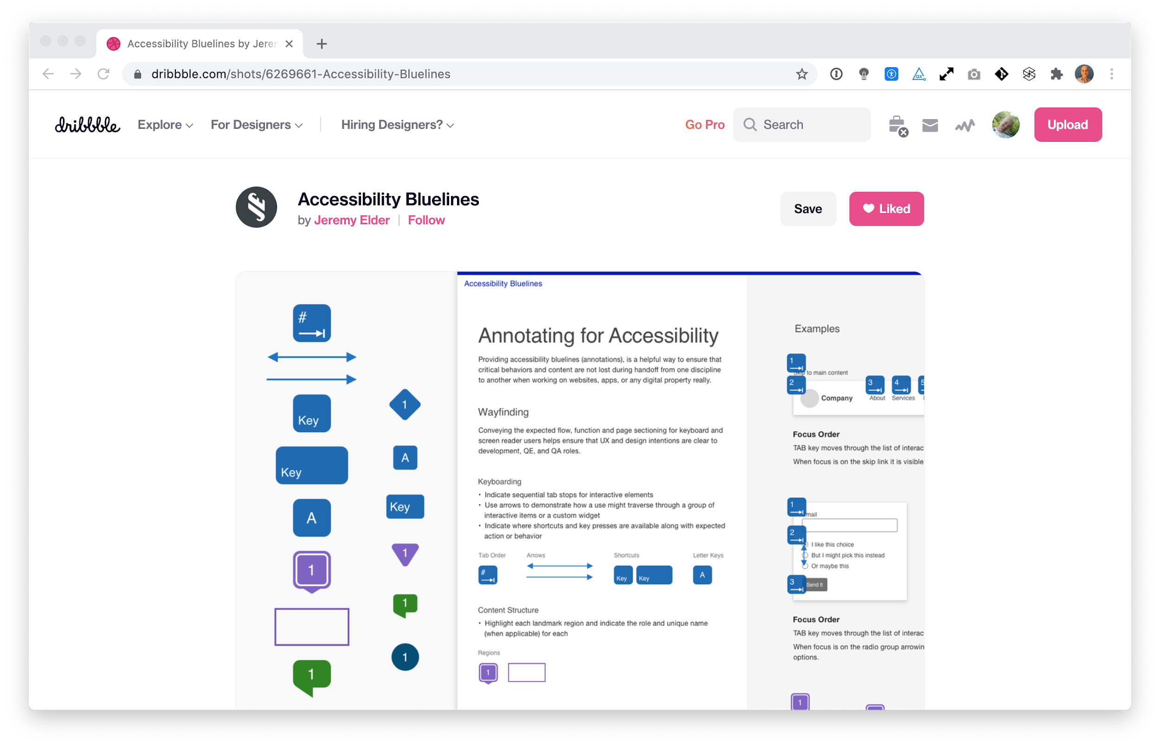

Accessibility Bluelines Design Assets
bit.ly/a11y-bluelines
Download includes marker symbols, documentation, and example use (Sketch, Figma, Adobe XD, and InVision Studio versions).
Extended by Jeremy Elder, GitLab

Slide 17
Screen Readers
How do they work?

Slide 18
How do assistive technologies work?
Web Browser
Braille Display
Server
HTML code
Screen Reader
User
Pointing device
Accessibility API
Assistive Technology Examples

Slide 19
Understanding how screen readers announce
element
A Heading containing the title of the page
role
A navigation region, also known as landmark, containing navigation items
state
A link that has been visited will indicate "visited", or a select menu is "expanded"
label
A button with a label called "Sign in"

Slide 20
How are things announced?
element
Put all of these together when this is on focus.
+
state
+
label
=
role

Slide 21
A new link
screen reader says:
element
state
label
link
+
new
+
About us
=
Link, "About us"

Slide 22
A visited link
screen reader says:
element
state
label
link
+
new
+
About us
=
Link, "About us"
link
+
visited
+
About us
=
Link, visited, "About us"

Slide 23
Augmenting announcements with ARIA
screen reader says:
element
state
label
link
+
new
+
About us
=
Link, "About us"
link
+
visited
+
About us
=
Link, visited, "Learn about us"
Augment announcement with ARIA
arial-label="Learn about us"

Slide 24

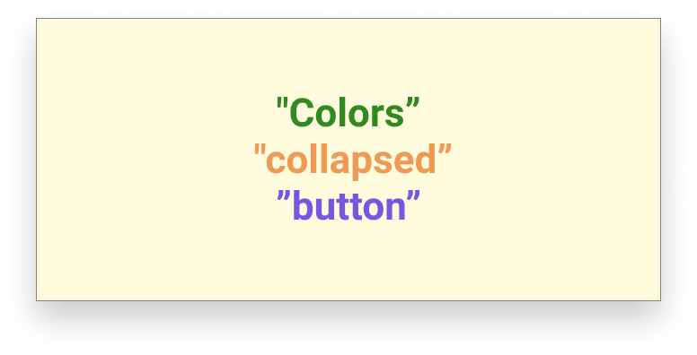
screen reader says:
"Colors", collapsed, button

Slide 25
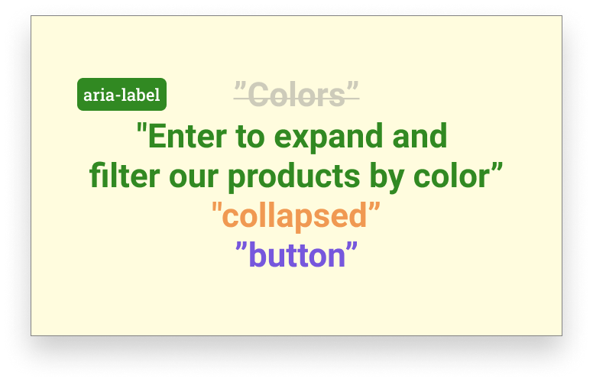
screen reader says:
"Enter to expand and filter our products by color", collapsed, button

Slide 26
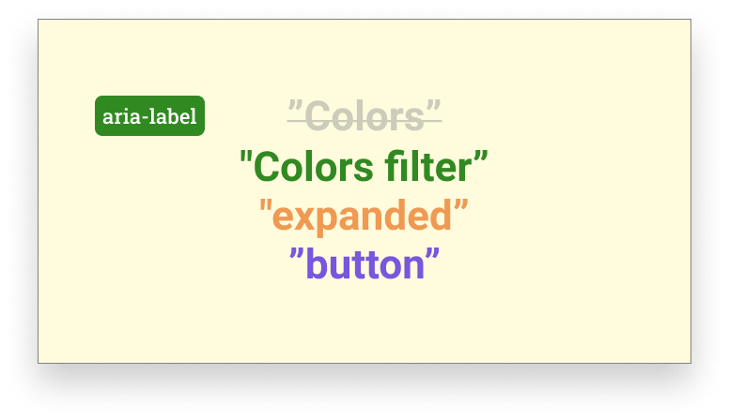
screen reader says:
"Colors filter", expanded, button

Slide 27
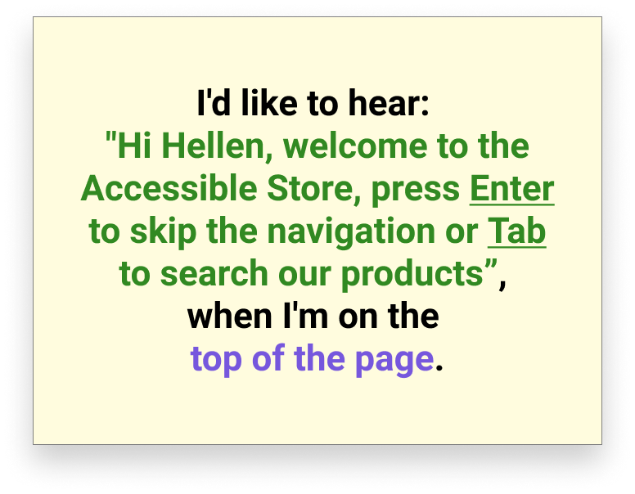
When
are things announced?

Slide 28
When
are things announced?
Whenever a screen reader stops
something is announced

Slide 29
Designing with Intent Interface Layout Architecture

Slide 30
Landmarks (or regions) are important! Think of them as "grouping" layers

Slide 31
Extended by Jeremy Elder, GitLab

Slide 32
banner
content

Slide 33
banner
search
secondary navigation
primary navigation
content

Slide 34
banner
search
secondary navigation
primary navigation
content
breadcrumbs
filter
sort
products
article
article
article

Slide 35
banner
"Hi Helen, welcome back to our Accessible e-store", banner
article

Slide 36
article
"Slim Sweatshirt, 24.99", article

Slide 37


Landmarks are like train stations
Photo by Oliver Cole on Unsplash

Slide 38
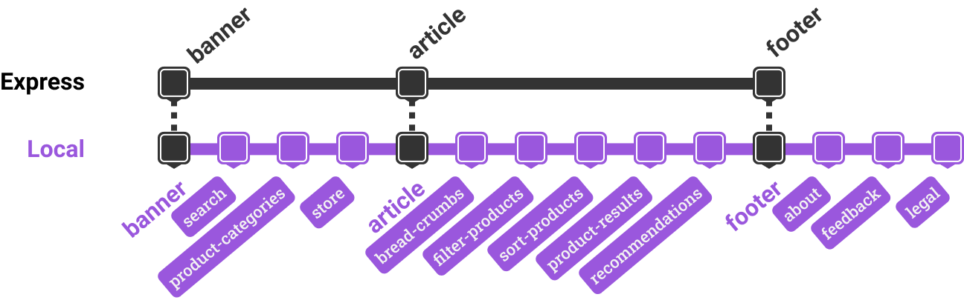
Landmarks are like train stations

Slide 39
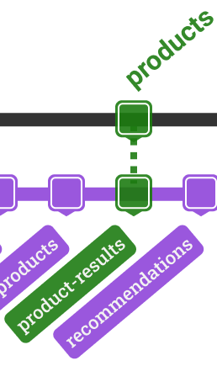
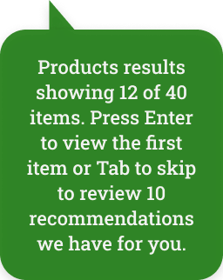
Each stop, there's an announcement

Slide 40
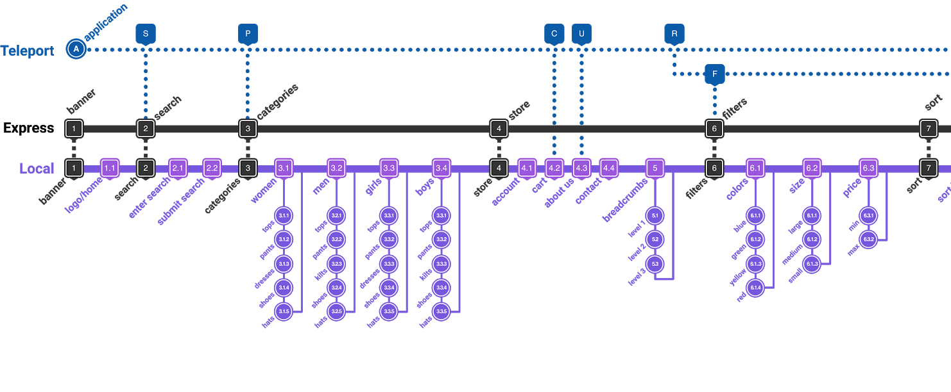
Wayfinding Diagram

Slide 41
Collaborating
with content designers and developers

Slide 42
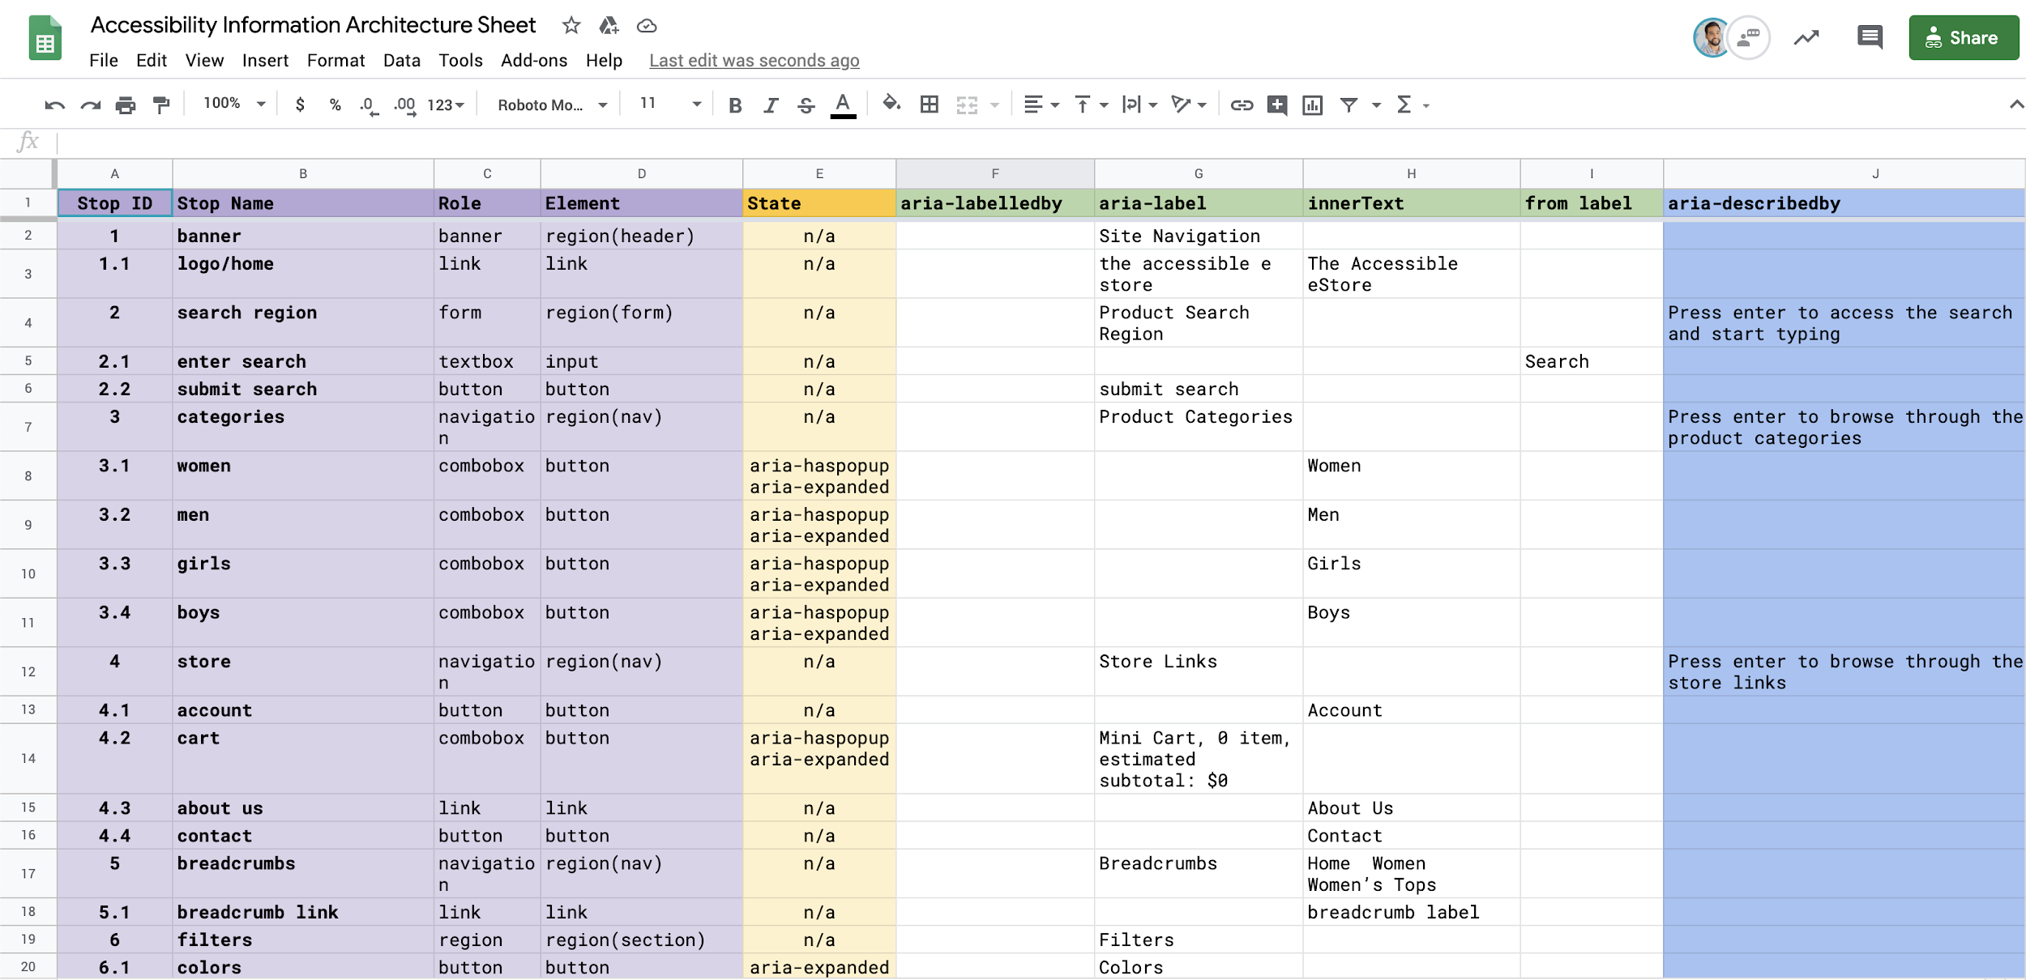
Accessibility Information Architecture

Slide 43
Rapid Prototyping
for Accessibility

Slide 44
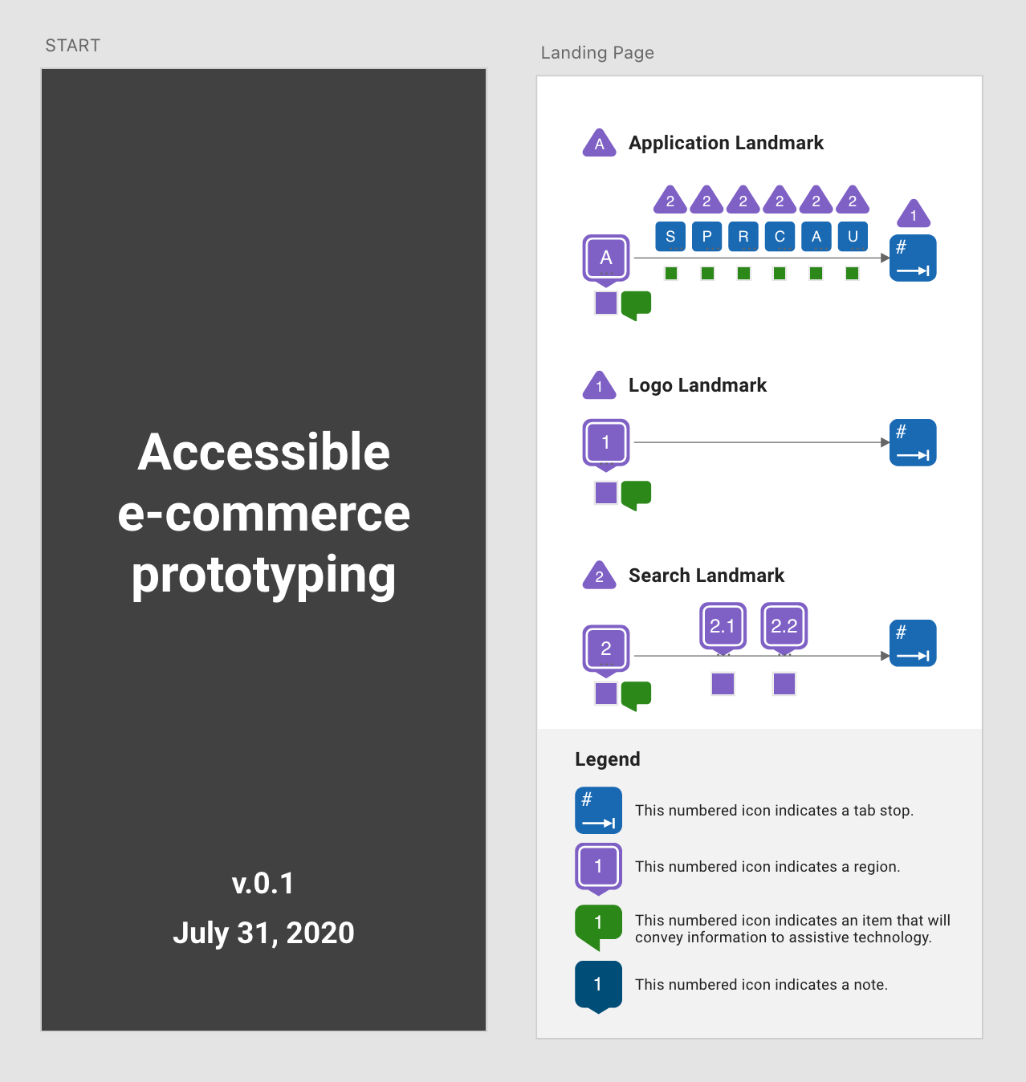
Adobe XD
Keyboard triggers
Voice command
Voice playback
Audio playback

Slide 45
User Testing
with People with Disabilities

Slide 46
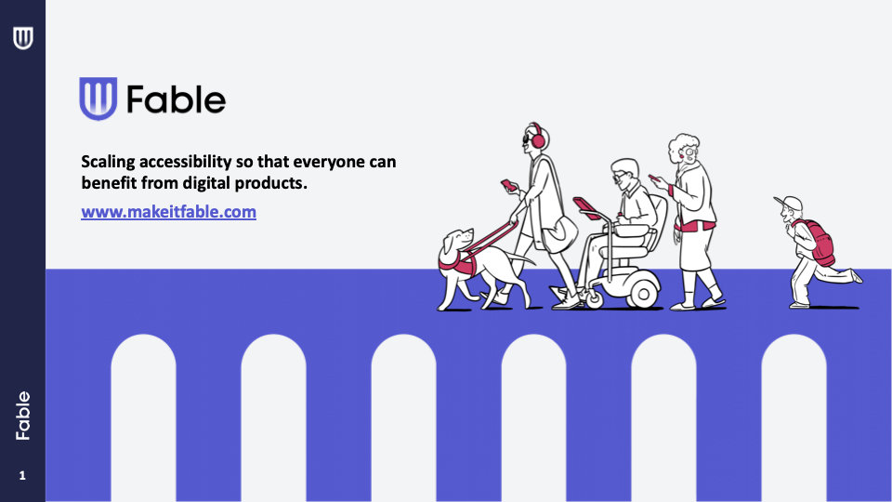

Slide 47
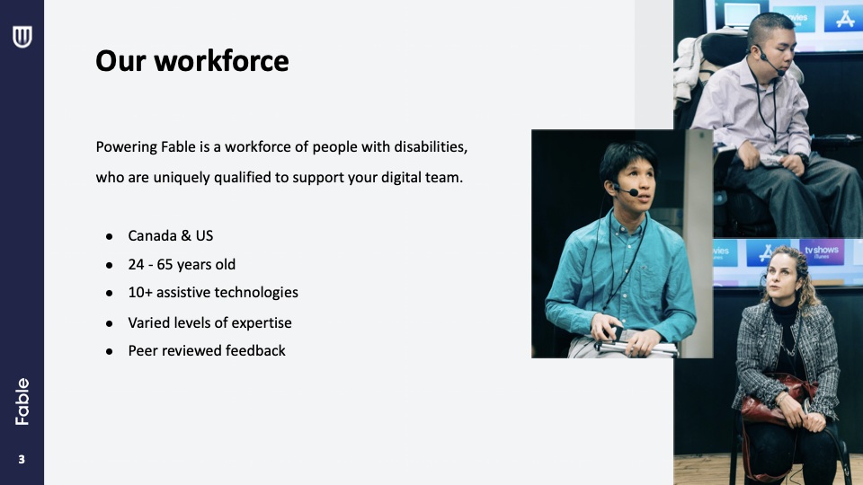

Slide 48
Summary
Inclusive Design is not a technique, It is a design philosophy
It is a mindset for Diversity & Inclusion

Slide 49
Accessibility
is one piece of inclusive design, but it doesn’t consider many of the areas such as culture, identity, different socio-economic challenges.

Slide 50
Accessibility by Design

Slide 52

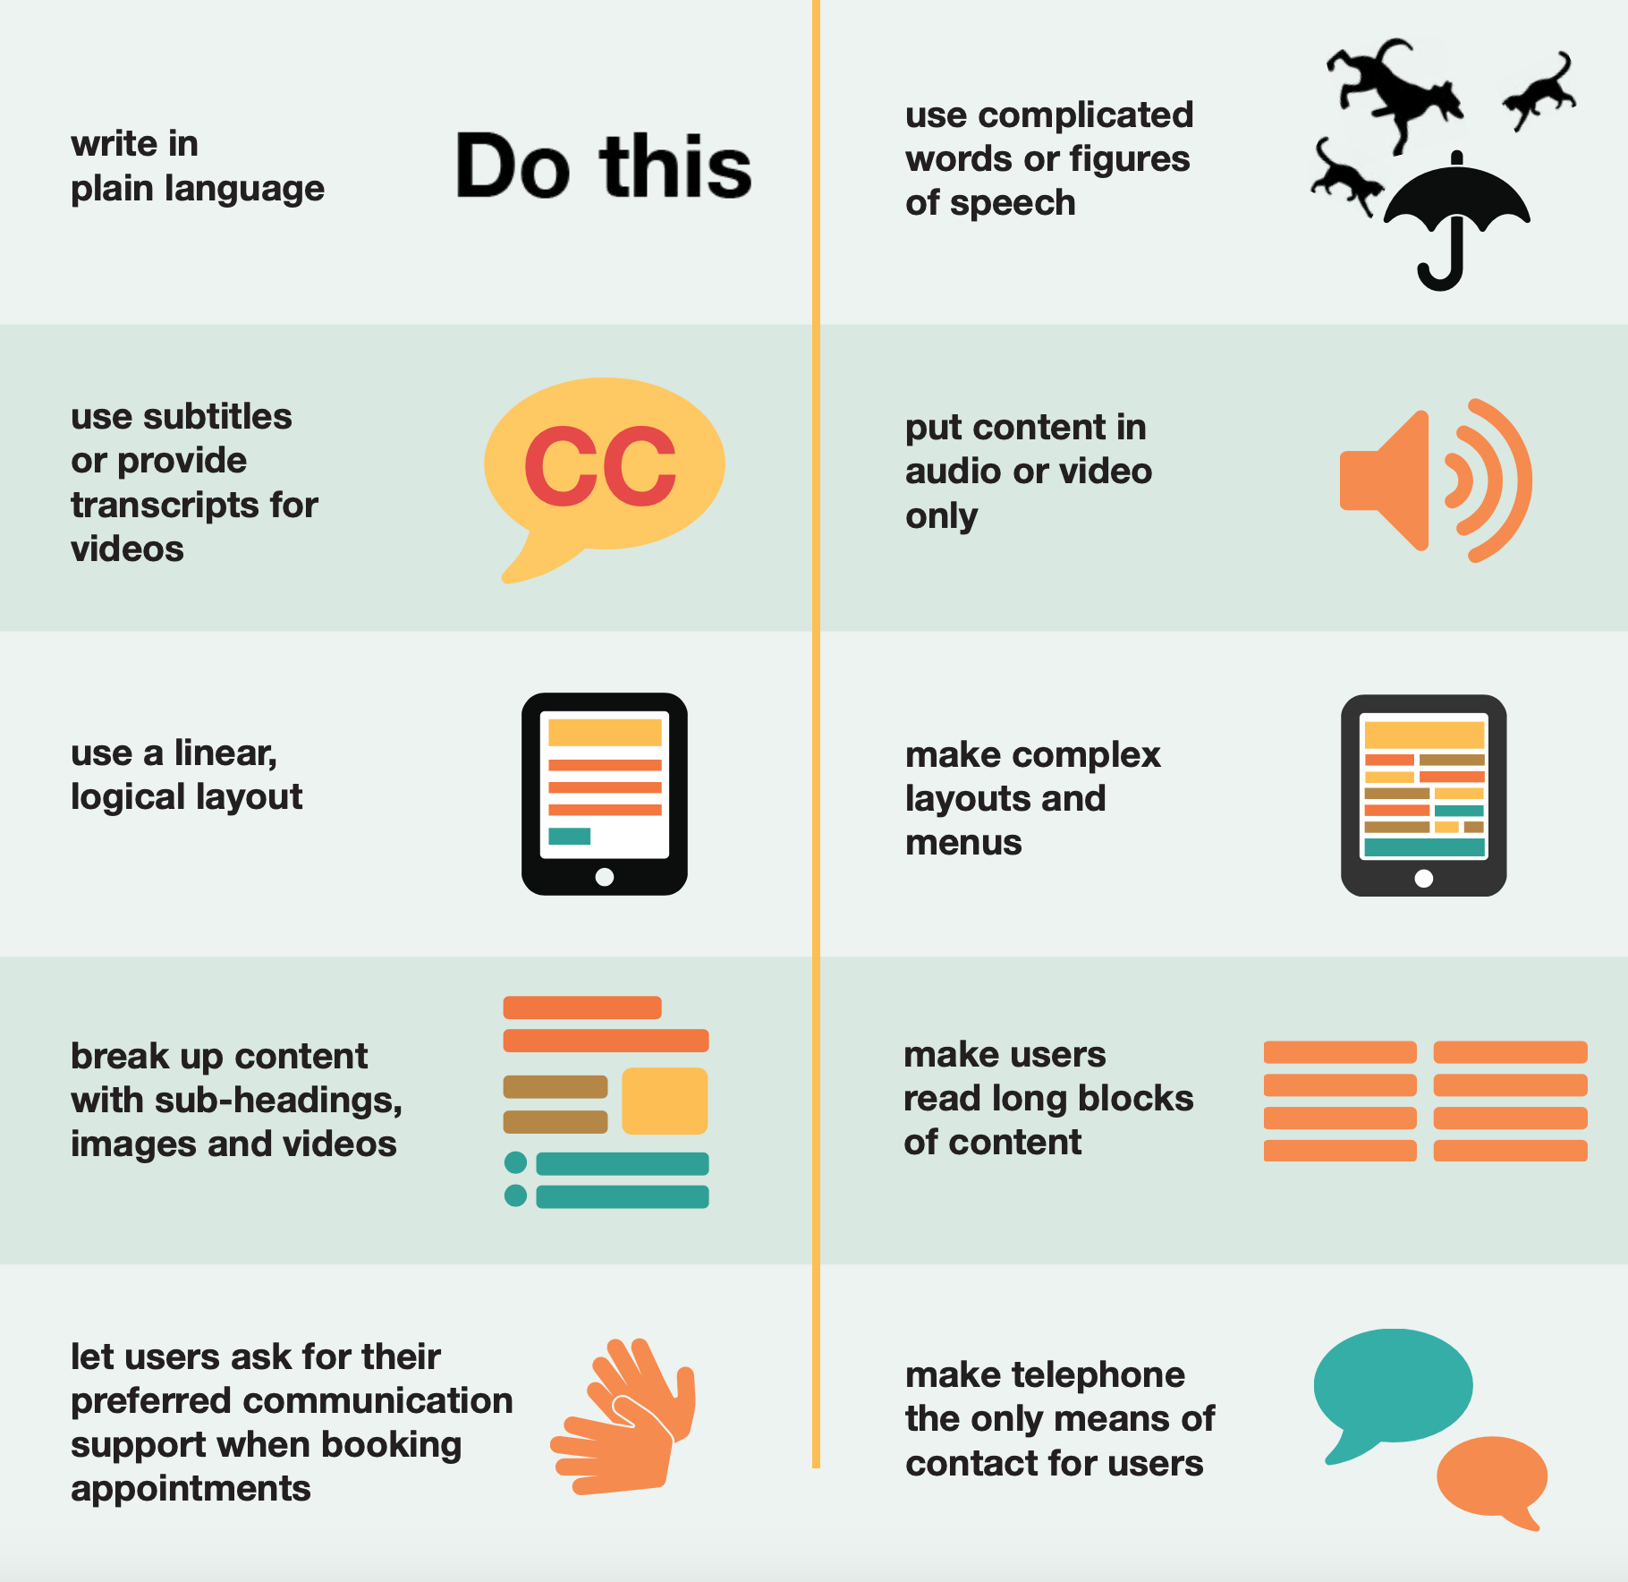
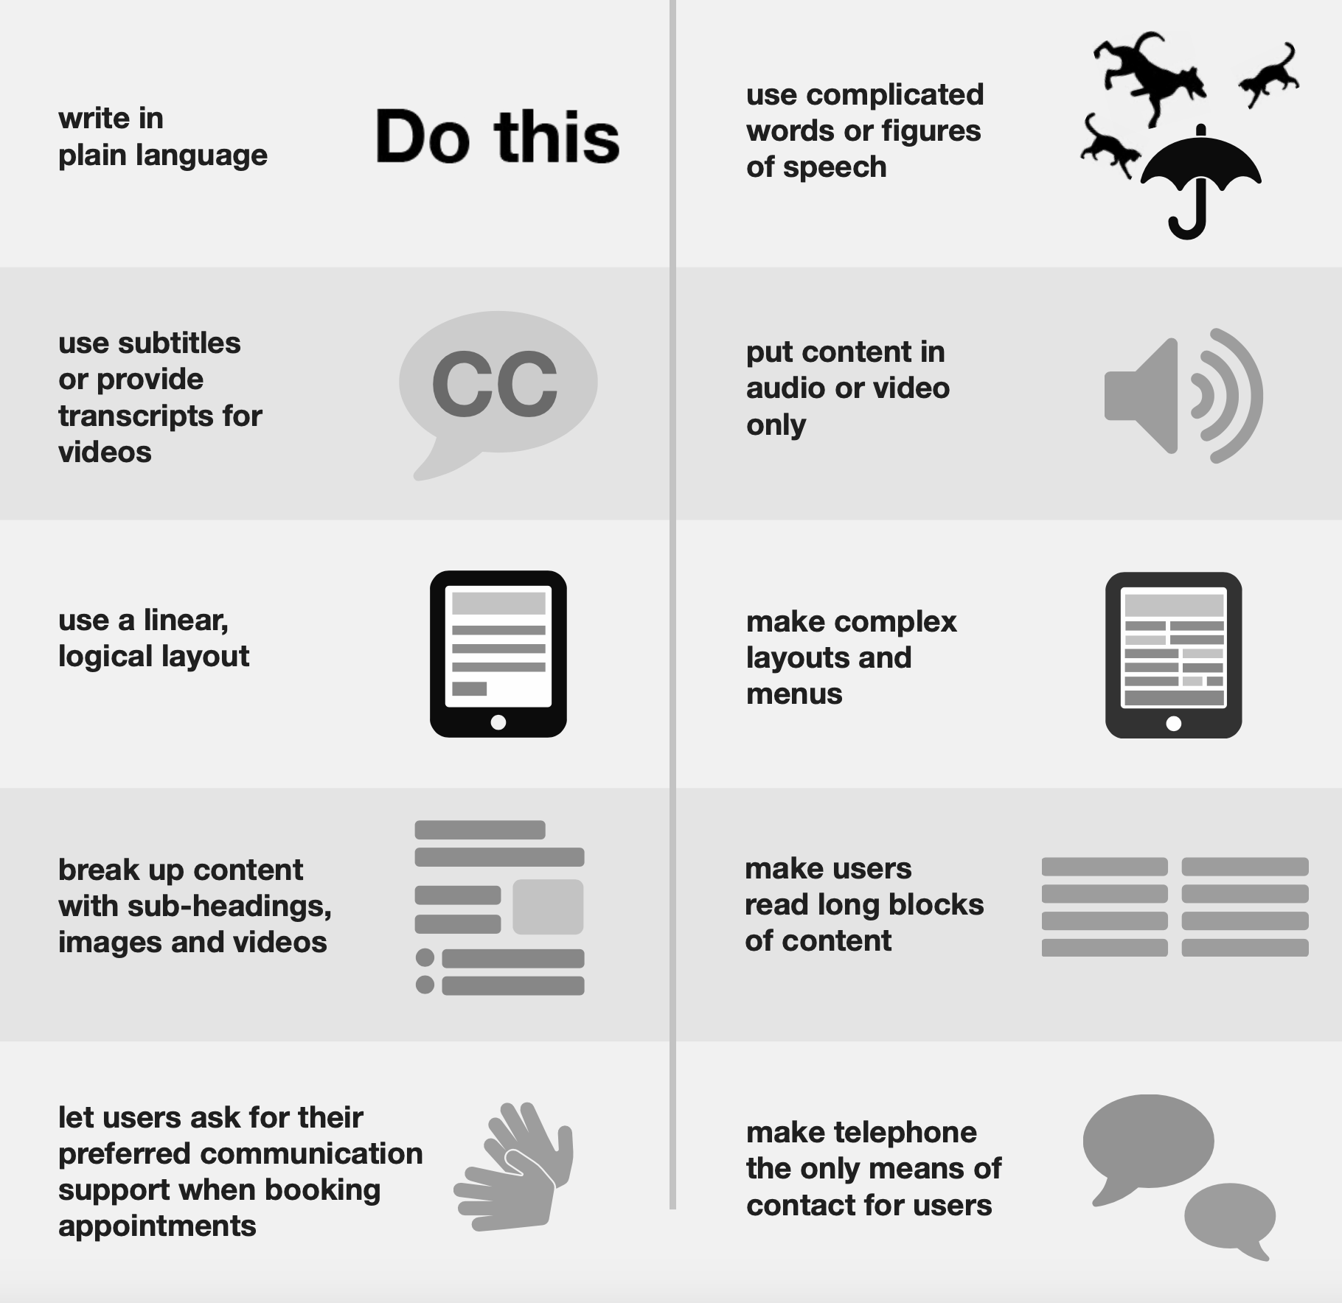


Consider users with
Deafness
Do...
Don't...
16%
of adults
33%
age 65~74
91%
age 50+
Nearly 16% of adults in the U.S. report hearing trouble.
Put another way, one of out of 5 men and one of out of 8 women report they have at least some trouble hearing.
Hearing loss is twice as common as diabetes or cancer.
About 11% of Americans report tinnitus, or ringing in the ears
Approximately one in three people in the US between the ages of 65 and 74 has hearing loss, and nearly half of those older than 75 have difficulty hearing.
Age is the strongest predictor of hearing loss among adults; 91% of adults with hearing loss are aged 50 and older.
Source: https://www.healthyhearing.com/report/52814-Hearing-loss-statistics-at-a-glance#
https://ukhomeoffice.github.io/accessibility-posters/posters/accessibility-posters.pdf

Slide 53

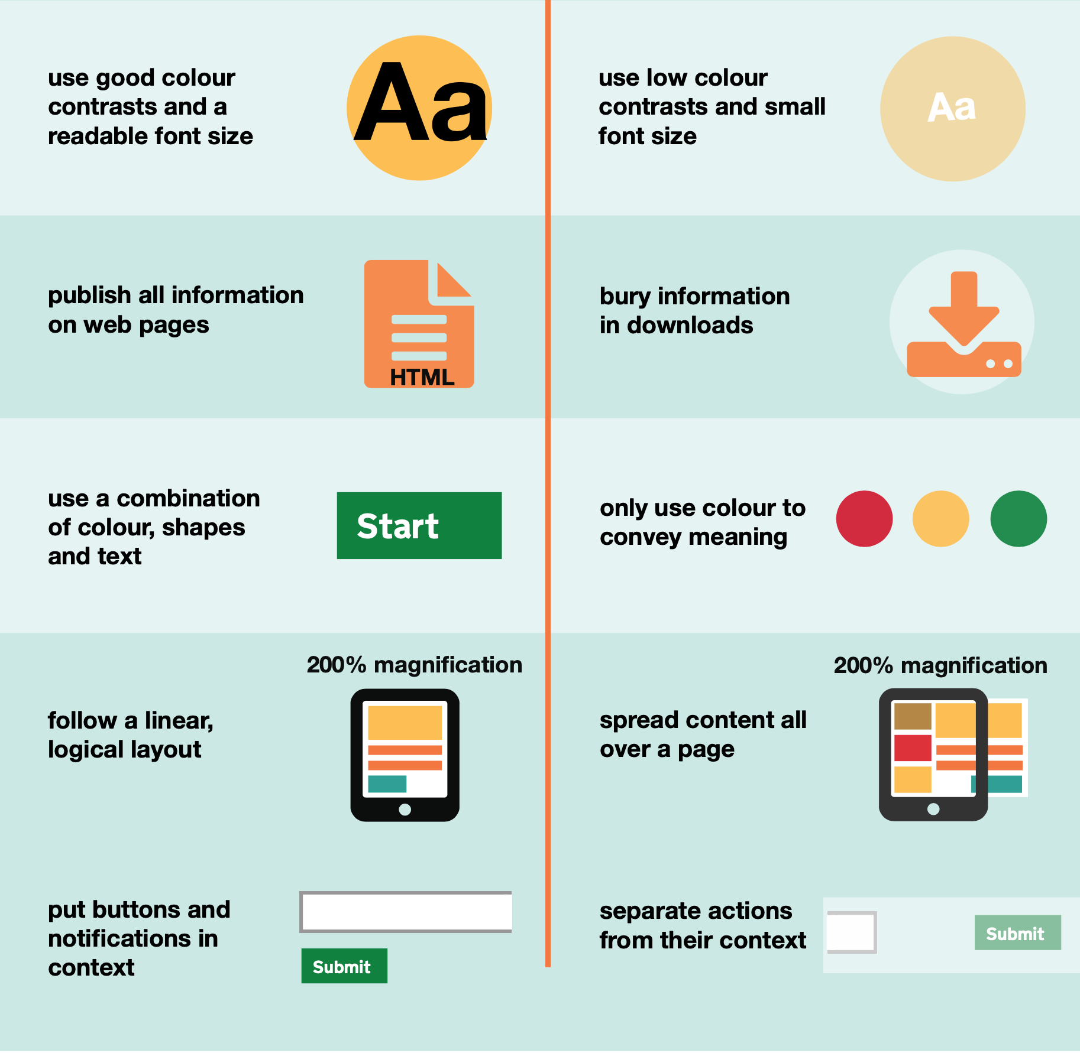
Consider users with
Low Vision
Do...
Don't...
Low Vision 2.9 million
Americans age 40+
Visually Impaired 4.2 million
Americans age 40+
Color Blindness ~8% of male population
in the United States
More than 2.9 million Americans age 40 and older have low vision - best-corrected visual acuity worse than 20/40; excludes those who are legally blind
Nearly 4.2 million Americans age 40 and older are visually impaired - Best-corrected visual acuity worse than 20/40 in the better-seeing eye; includes both those with low vision and those who are legally blind
Approximately 8% of men and 0.5% of women among populations with Northern European ancestry have the most common form of color blindness that makes it hard to see red or green
Source: https://www.aao.org/newsroom/eye-health-statistics
https://ukhomeoffice.github.io/accessibility-posters/posters/accessibility-posters.pdf

Slide 54

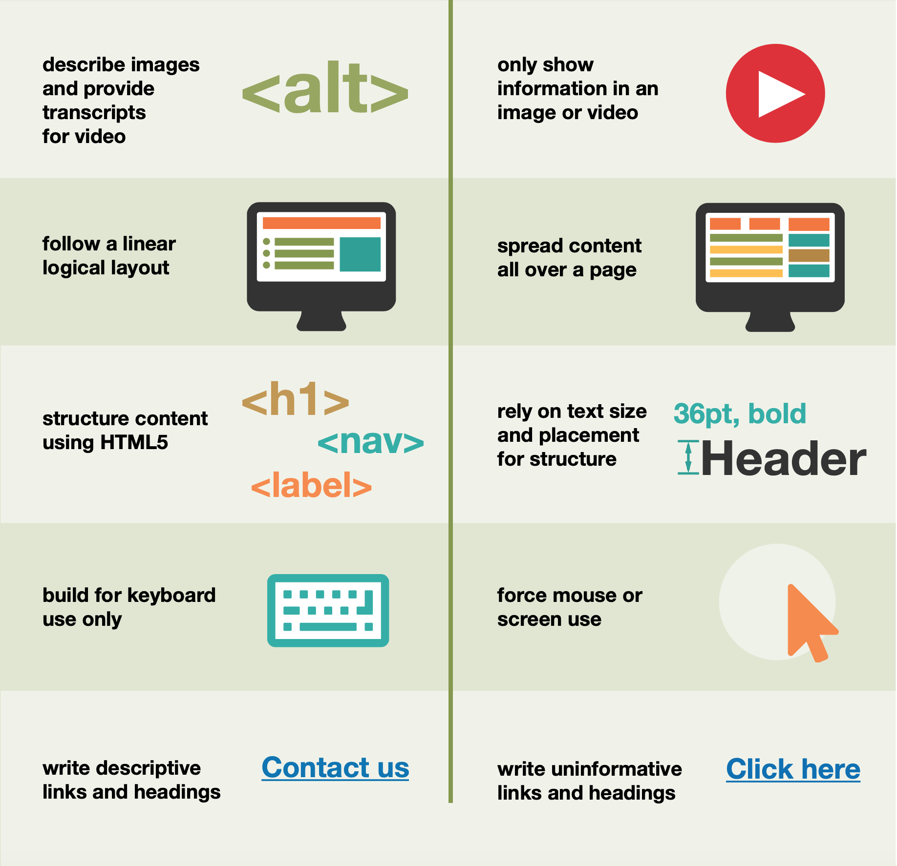
Do...
Don't...
Consider users with
Assistive Technologies
Significant Vision Loss 23 million
Americans age 40+
Significant Vision Loss 9.2 million
Americans age 65+
Color Blindness ~15% of adult population
in the United States
“Vision Loss” refers to individuals who reported that they have trouble seeing, even when wearing glasses or contact lenses, as well as to individuals who reported that they are blind or unable to see at all.
23.0 million American adults between the ages of 18 and 64 and 9.2 million American adults 65 years and older report experiencing significant vision loss*.
This represents approximately 15.4% of American adults 18 or older.
In 2019 the entire US population of adults (18+) was 209,128,094.
*Data Source: IPUMS NHIS database: Blewett, L. A., Rivera Drew, J. A., King, M. L., and Williams, K. C. (2019). IPUMS health surveys: National Health Interview Survey (Version 6.4) [dataset]
https://ukhomeoffice.github.io/accessibility-posters/posters/accessibility-posters.pdf

Slide 55



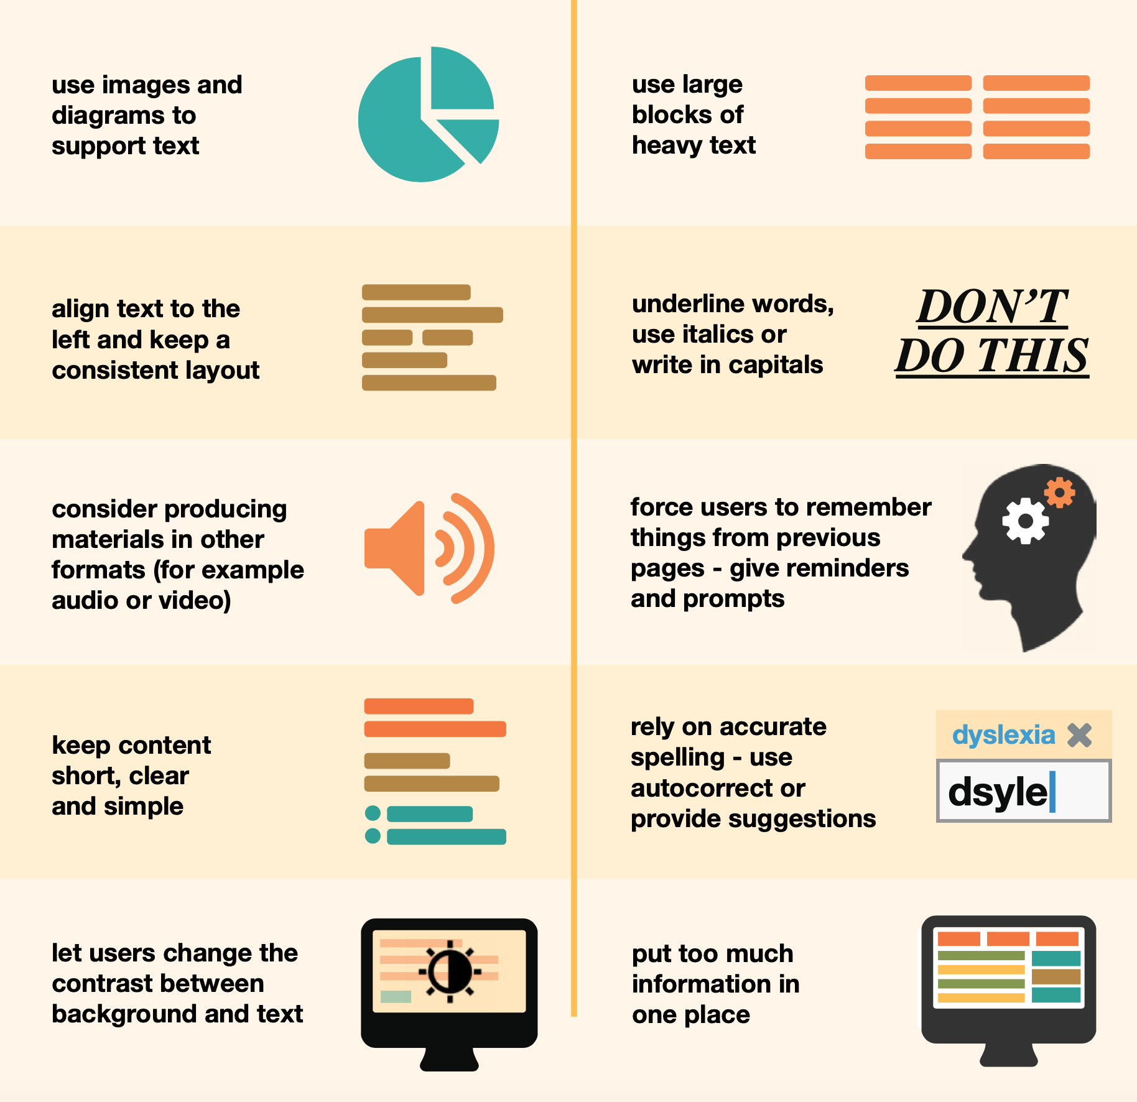
Do...
Don't...
Consider users with
Dyslexia
U.S. Population 20% living with Dyslexia
Over 40 million
Americans with Dyslexia
Only 2 million
Americans know it
Dyslexia affects 20 percent of the population and represents 80–90 percent of all those with learning disabilities.
Dyslexia is the most common of all neurocognitive disorders.
Dyslexia occurs at all levels of intelligence — average, above average and highly gifted.
Many gifted people at the top of their fields are dyslexic.
While people with dyslexia are slow readers, they often are very fast and creative thinkers.
Over 40 million American Adults are dyslexic - and only 2 million know it
The Yale Center for Dyslexia & Creativity
https://dyslexia.yale.edu/dyslexia/dyslexia-faq/
American Dyslexia Association, The International Dyslexia Association, The Dyslexia Center, The Dyslexia Foundation, The Child Mind Institute
https://ukhomeoffice.github.io/accessibility-posters/posters/accessibility-posters.pdf
Notes:
https://austinlearningsolutions.com/blog/38-dyslexia-facts-and-statistics

Slide 56

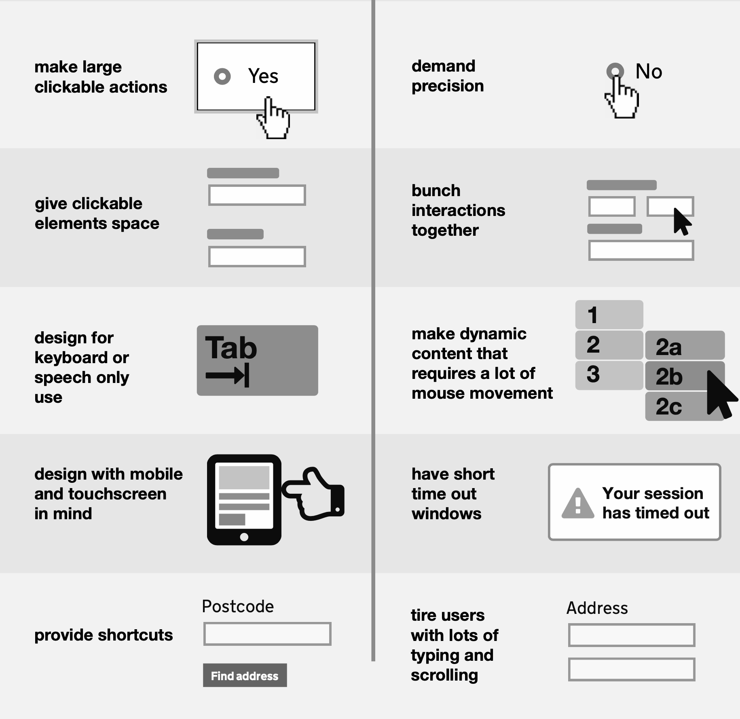
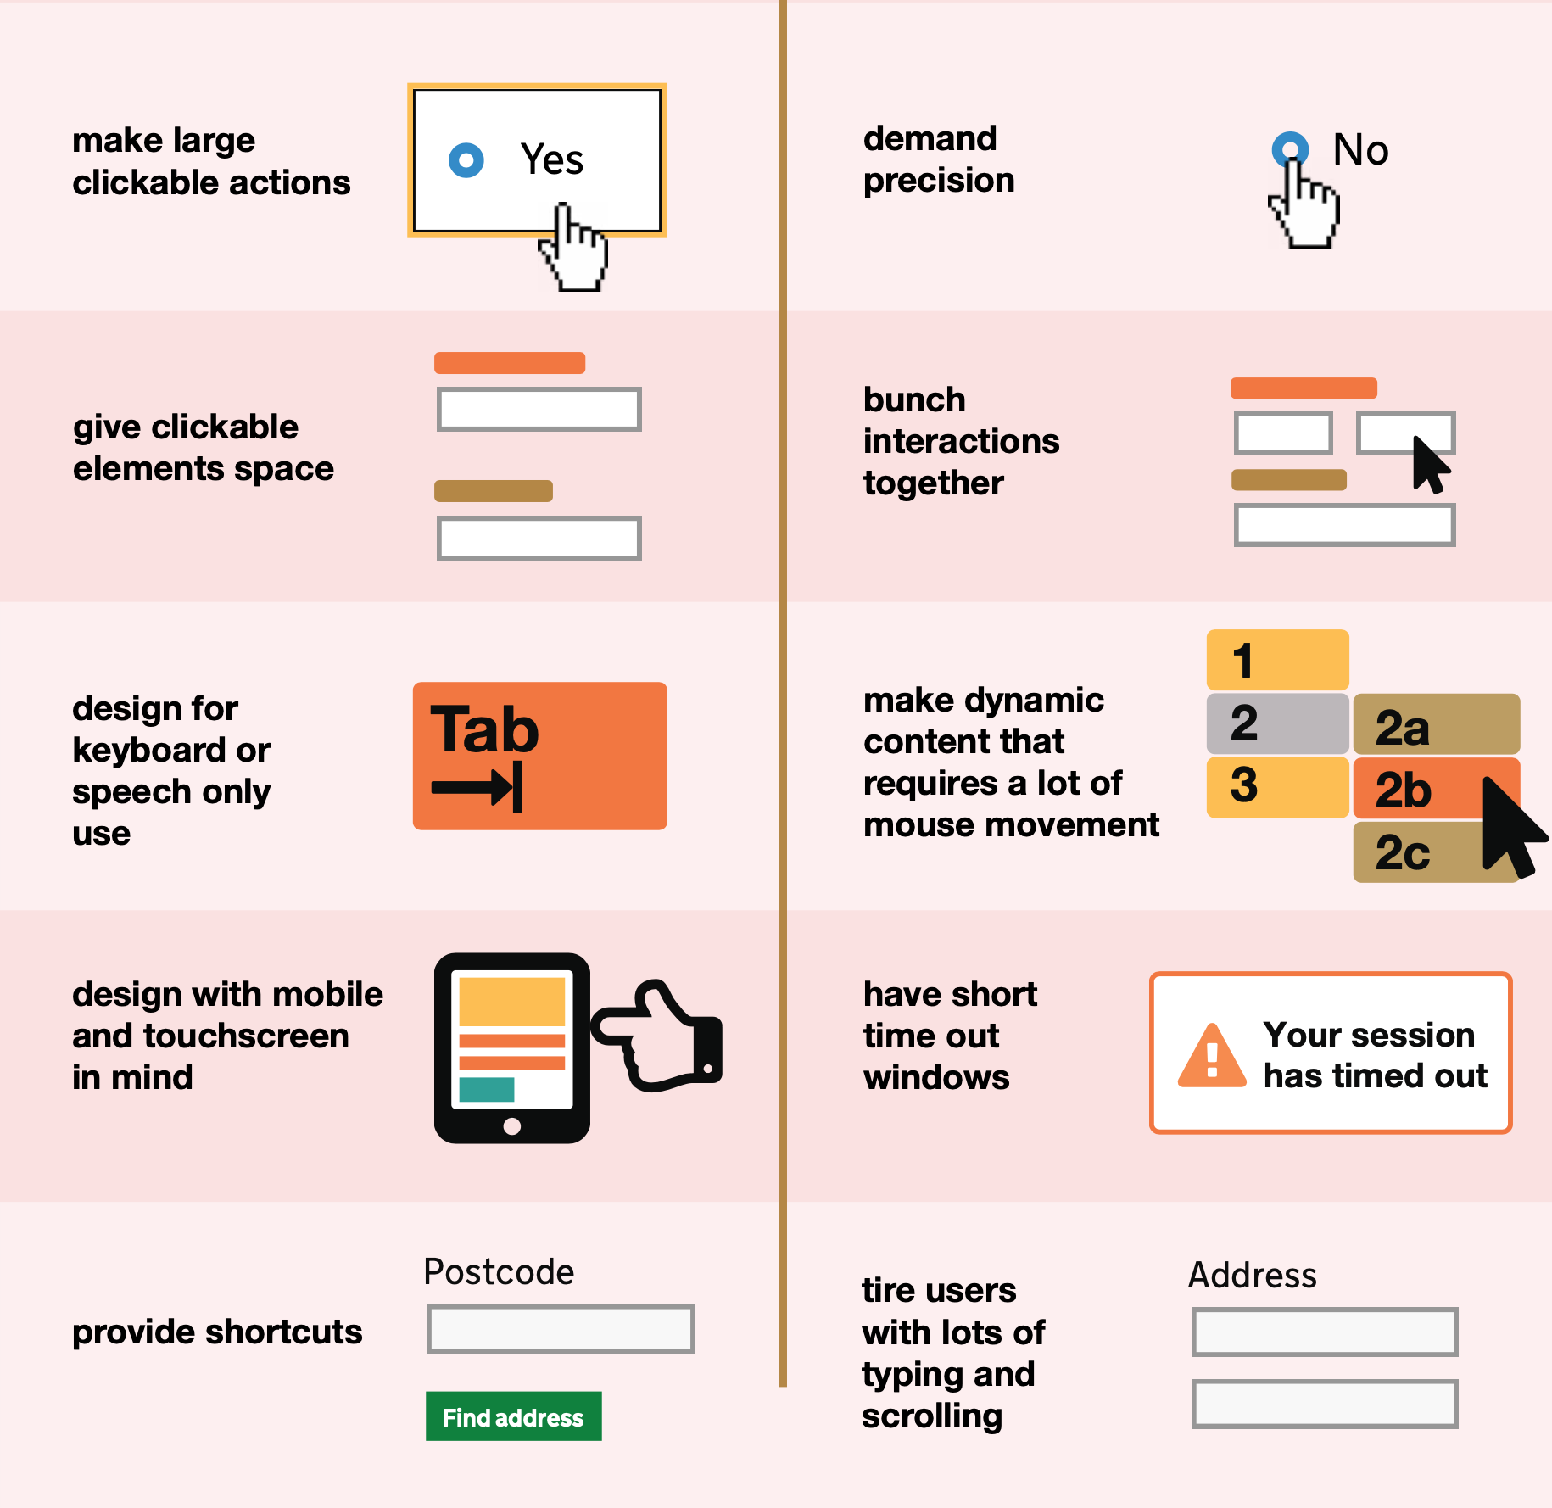
Consider users with
Physical or Motor Disabilities
Do...
Don't...
U.S. Population 16% difficulties with their physical functioning
Over 39 million
difficulties with their physical functioning
Only 17 million
can't walk unassisted for a ¼ mile
16 percent of people in the US (39 million people) have difficulties with their physical functioning. 17.1 million would find it very difficult or impossible to walk unassisted for a quarter mile.*
Conditions That Impair Gross and Fine Motor Skills**
TRAUMATIC INJURIES
Spinal cord injury
Loss or damage of limb(s)
MOTOR DISABILITIES
Cerebral palsy
Muscular dystrophy
Multiple sclerosis
Spina bifida
ALS (Lou Gehrig's Disease)
Arthritis
Parkinson's disease
Essential tremor
*Source: https://www.cdc.gov/nchs/fastats/disability.htm
**Source: https://webaim.org/articles/motor/motordisabilities
https://ukhomeoffice.github.io/accessibility-posters/posters/accessibility-posters.pdf

Slide 57

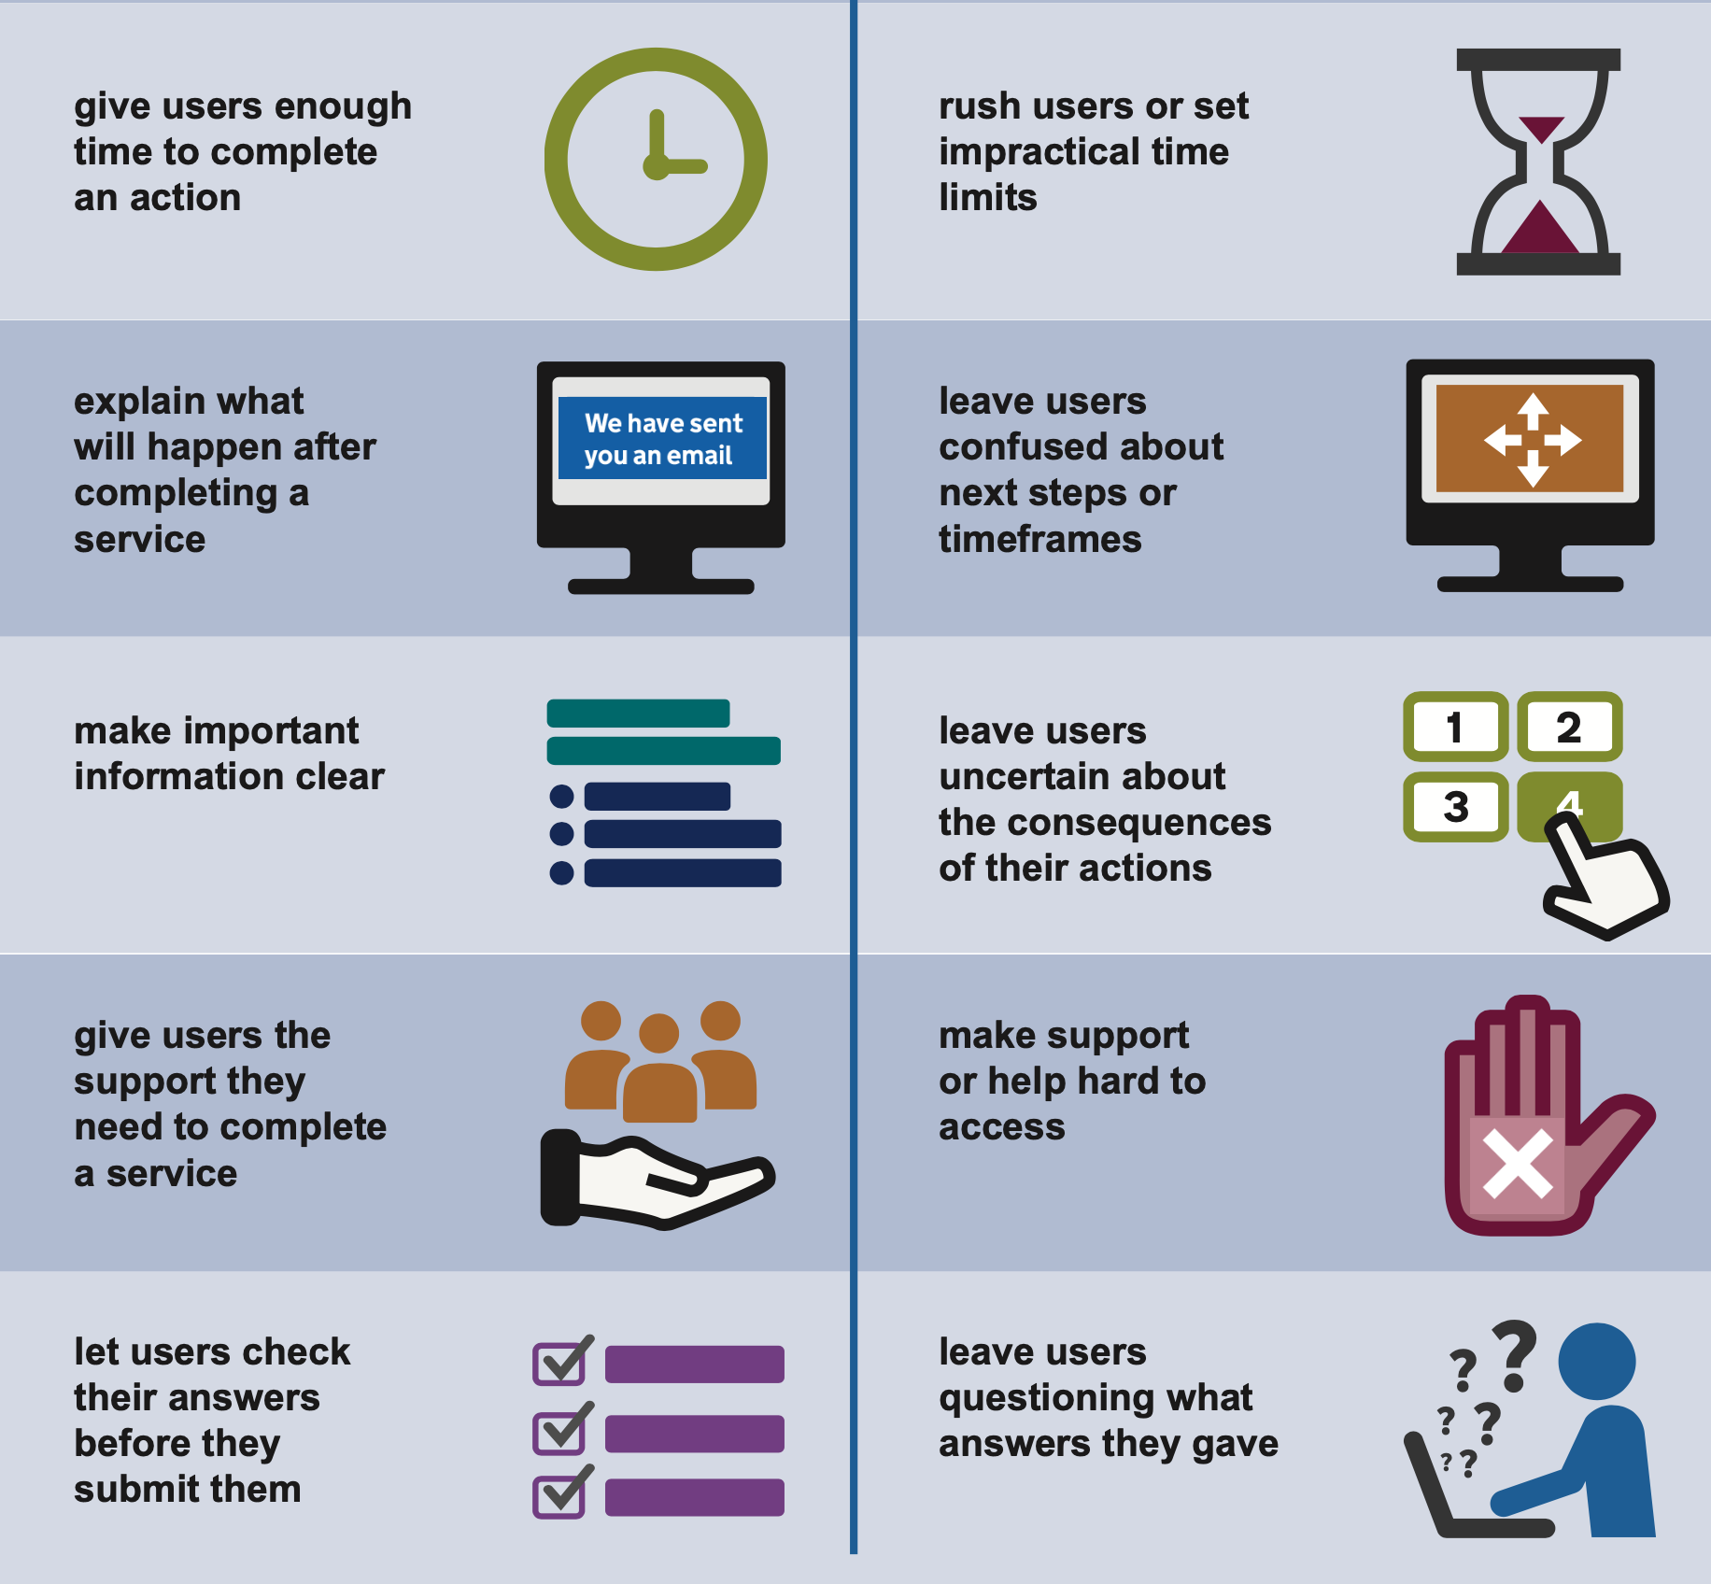
Do...
Don't...
Consider users with
Anxiety
40 million adults
with Anxiety
19 million adults
experience phobias
7.7 million
Adults with PTSD
Anxiety is the most common mental disorder in the U.S., affecting 40 million adults (ADAA, 2020)
The majority of adults with anxiety have a mild impairment (43.5%), 33.7% have a moderate impairment, and 22.8% have a serious impairment (NIMH, 2017)
19 million adults experience specific phobias, making it the most common anxiety disorder in America (ADAA, 2020)
15 million adults have social anxiety (ADAA, 2020)
7.7 million adults have PTSD (ADAA, 2020)
6.8 million adults have generalized anxiety disorder (GAD) (ADAA, 2020)
6 million adults have panic disorders (ADAA, 2020)
Source: https://www.singlecare.com/blog/news/anxiety-statistics/
https://ukhomeoffice.github.io/accessibility-posters/posters/accessibility-posters.pdf

Slide 58

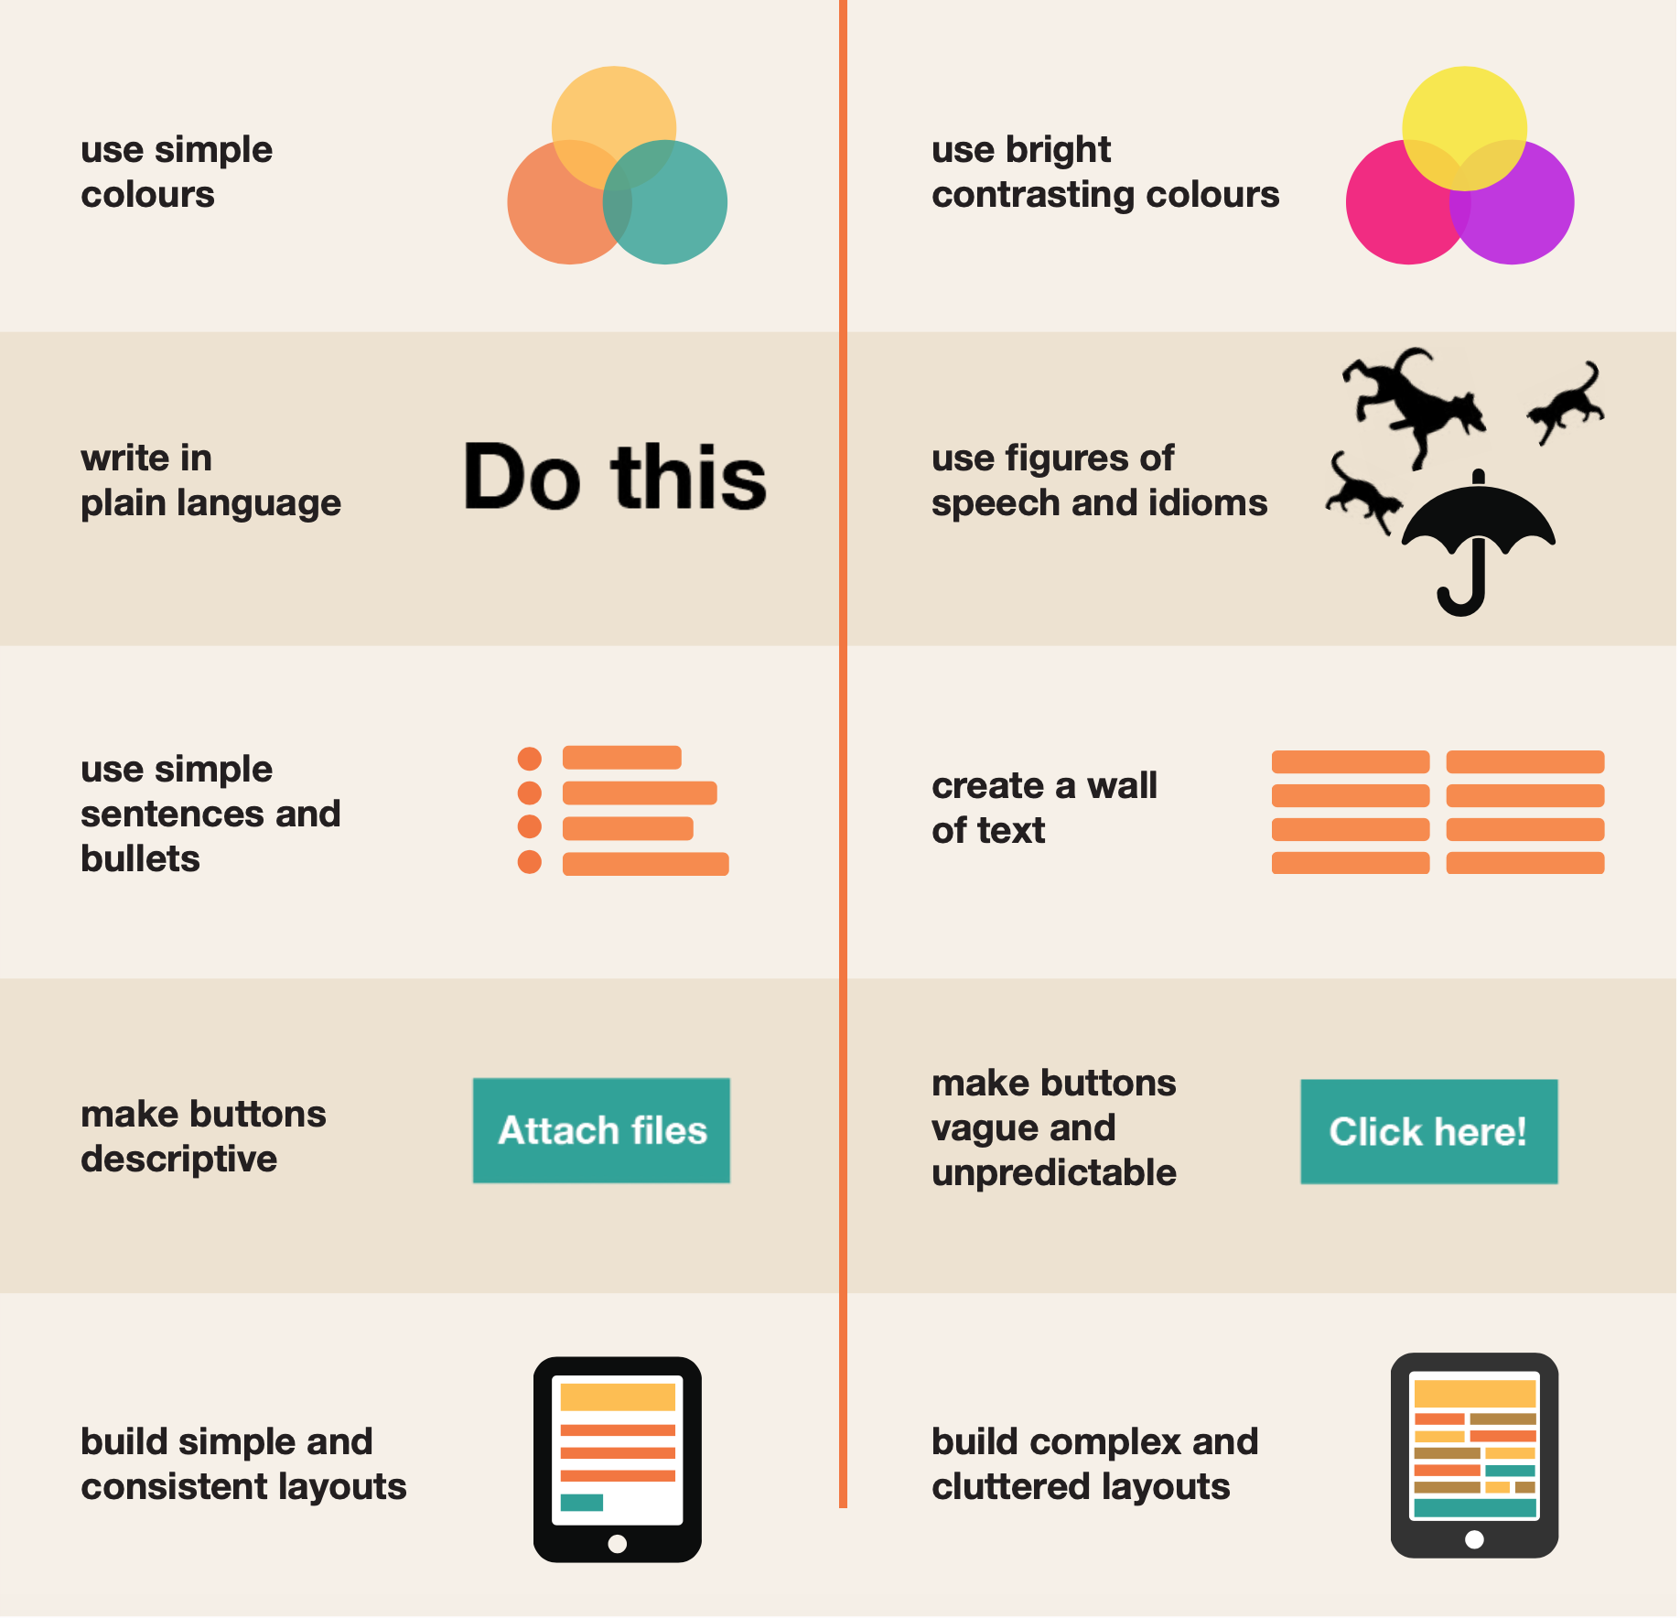
Do...
Don't...
Consider users with
Neurodivergent Conditions
17% million adults
with Anxiety
29% ADD/ADHD pop. with Depression
12% ADD/ADHD pop. with Bipolar Disorder
Neurodivergent conditions include Autism Spectrum Disorder (ASD), Attention Deficit Hyperactivity Disorder (ADHD) and Dyslexia. It has been reported that up to 17 percent of the population have been diagnosed with a neurodivergent condition:
Four percent have ADD/ADHD
One percent have Autism
10 percent have Dyslexia
One percent have Dyspraxia
One percent have Tourette Syndrome
When you consider that many conditions go undiagnosed, 17 percent is therefore likely to be conservative at best. The World Health Organization noted that the prevalence of neurological conditions is one of the greatest threats to public health.
Source: https://www.workdesign.com/2019/12/designing-for-neurodiversity-and-inclusion/
https://ukhomeoffice.github.io/accessibility-posters/posters/accessibility-posters.pdf

Slide 59
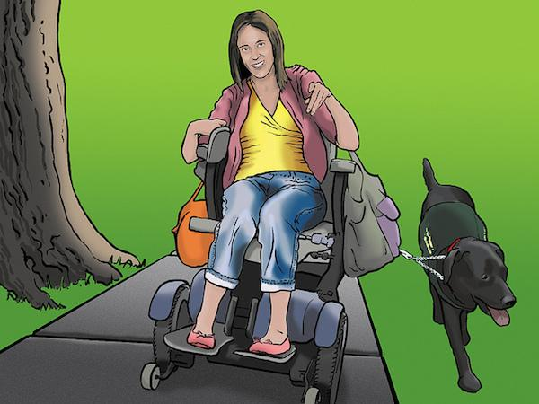
Emily Cerebral palsy, living independently
Wants to do everything for herself
24 years old
Works part-time at a local community center
Overview
Difficult to use hands and has some difficulty speaking clearly; uses a motorized wheelchair
Uses the computer well, with the right input device; good at finding efficient search terms
Wants to do everything for herself; can be impatient.
Assistive Technology
Augmented & Alternative Communication (AAC) with speech generator.
Scooter with joystick control, iPad attached

Slide 60
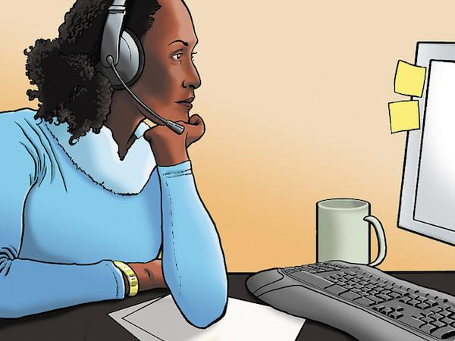
Lea Living with fatigue and pain
No one gets that this really is a disability.
35 years old
Masters degree
Writes for a trade publication; works from home
Overview
Fatigue from fibromyalgia, trackball, and special keyboard
Average user
Wishes people would understand how hard it can be for her to make it through the day
Assistive Technology
Split keyboard for less strain on her wrists
Keyboard controls to minimize arm movement
Dragon Naturally Speaking (speech recognition)

Slide 61
Lea Living with fatigue and pain
No one gets that this really is a disability.
5
million
people in the U.S. live with fibromyalgia,
80–90% of them are women
People with fibromyalgia and related diseases like lupus, ankylosing spondylitis, and rheumatoid arthritis have increased sensitivity to pain.
Source: National Institute of Arthritis and Musculoskeletal and Skin Diseases
35 years old
Masters degree
Writes for a trade publication; works from home
Overview
Fatigue from fibromyalgia, trackball, and special keyboard
Average user
Wishes people would understand how hard it can be for her to make it through the day
Assistive Technology
Split keyboard for less strain on her wrists
Keyboard controls to minimize arm movement
Dragon Naturally Speaking (speech recognition)

